Slide 1
Python: Part 5
Catherine and Annie

Slide 2

Functions
Remember a few days ago when we started Python and we told you that main is a function? But we never really told you what a function is.
A function (or method) is an encapsulated little chunk of code that usually performs some task for you.
Usually you will write a function when there is a task that you want to perform over and over again. Once a function is written, it can be used throughout a program
A function is written using the form

Slide 3
Writing a function
Writing your own functions is useful because often there are tasks that your program must do that are not built into Python (like calculating the average of a sequence of numbers). Writing your own function allows you to have a way of completing whatever task you need to.
Remember that we use loops to repeat a short section of code many times. Imagine if there was a chunk of code that was 20 lines long that you needed to use five times throughout your program. Would you rather type out the 20 lines five times or write a function just once?
All functions begin with a function header, which lets the computer know you’re writing a function
Examples:
def main():
def getAverage(x, y):

Slide 4
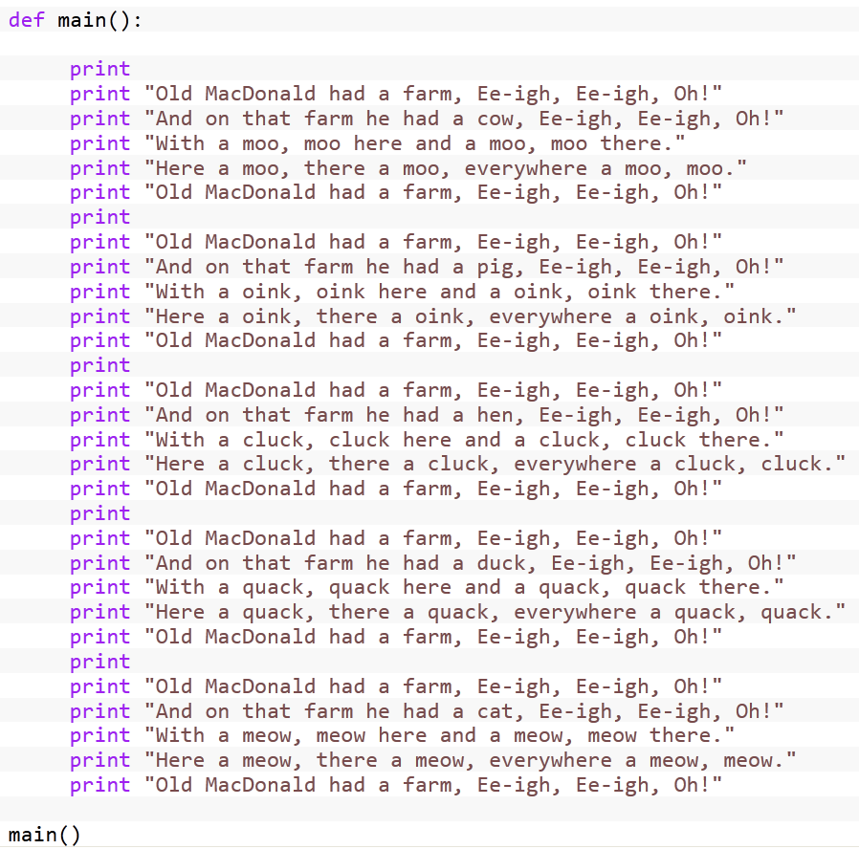
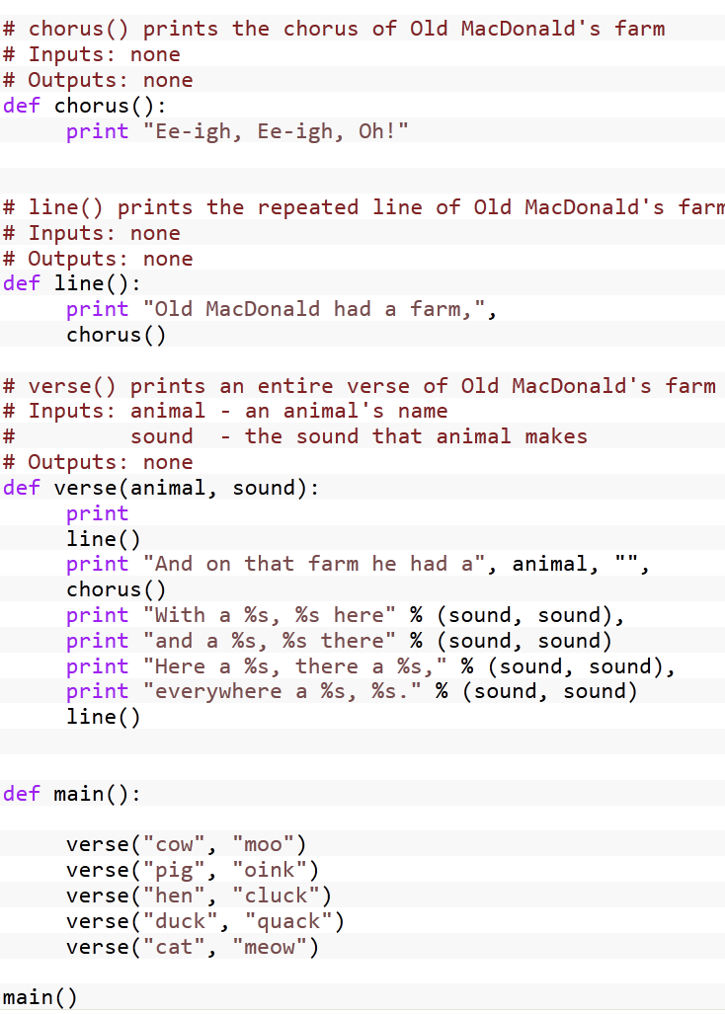
Example
No functions – just print statements
Using functions

Slide 5
More writing a function
Writing functions is simple – you’ve already done it, in fact!
Simply by putting code into main, like in all the programs you’ve written, you are writing a function.
The more difficult part is designing functions – deciding what you want your functions to do. You won’t have to worry too much about that though.
In Python, all functions that you write beside main have to go before main.

Slide 6
Calling functions
In order to have the computer execute the code in a function, you have to make a call to it – usually within another function. Kind of like how you have to make a reference to a variable in order to use it.
Open the file called “functionExample.py”
What will this program do? How can you tell?
How can you tell the difference between a variable and a function call?

Slide 7
Using parameters
You can also give values to a function so that the function can perform operation on those values
Example: passing three numbers to an averaging function so that the numbers’ average can be determined
Example: passing a list of numbers to a function that will calculate the sum of the numbers and tell you the length of the list
Parameters are contained in the parentheses after the function name.
When you pass values to a function as parameters, they should not be named the same as they are in the function header.

Slide 8
Returning values
Functions can also return values to the function that called them.
You can assign these values to variables, and then use those variables how you please
Example: A function returns a list of students in a class, and you then capitalize all the students’ name, and print the contents of the list to the screen.

Slide 9
An example
Open the file called “parameterExample.py”
What will this program do? How can you tell?
Let’s run this program and see what happens.
Is there anything you didn’t understand?

Slide 10
Your turn!
Open the file called “Python – Lesson 5 Exercises” and complete the exercises.

